Slide 1
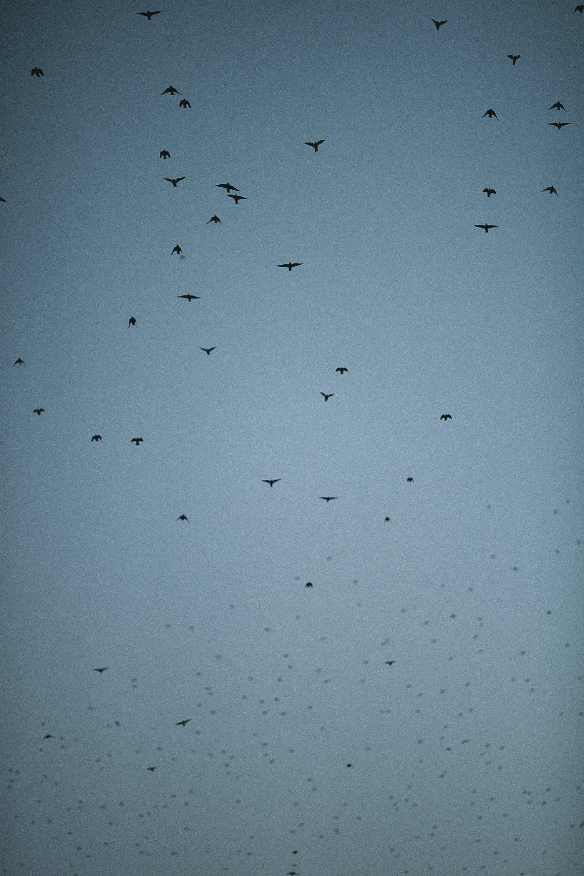

Bird Monitoring
and
Protection System
for Yancheng coastal Wetland

Slide 2
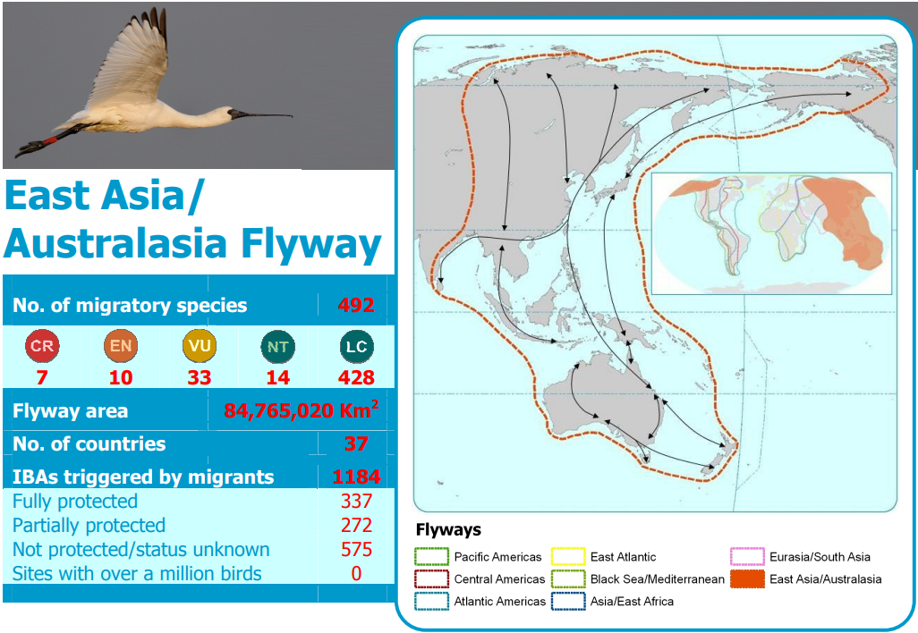
Current Problem
The East Asian-Australasian Flyway (EAAF) is the most threatened flyway worldwide,
with human-bird conflicts leading to habitat loss and degradation.

Slide 3
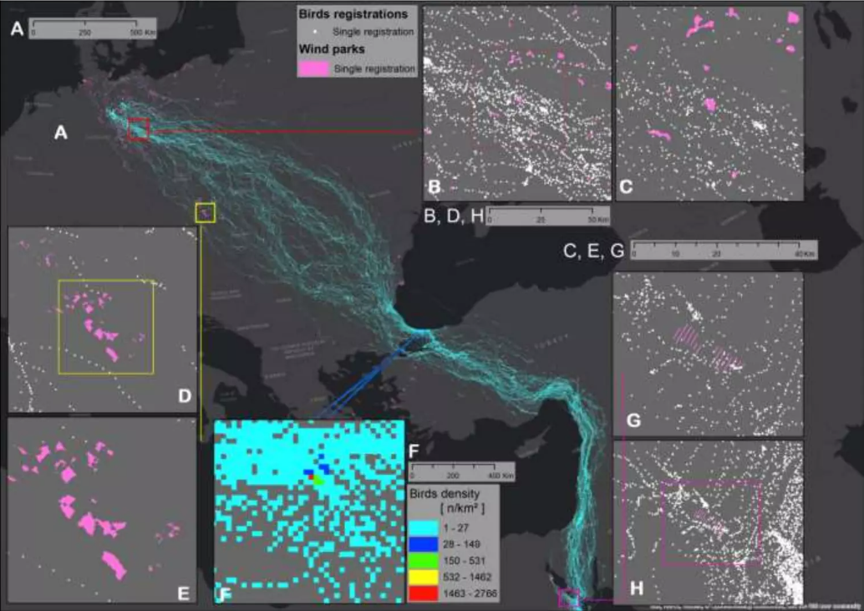
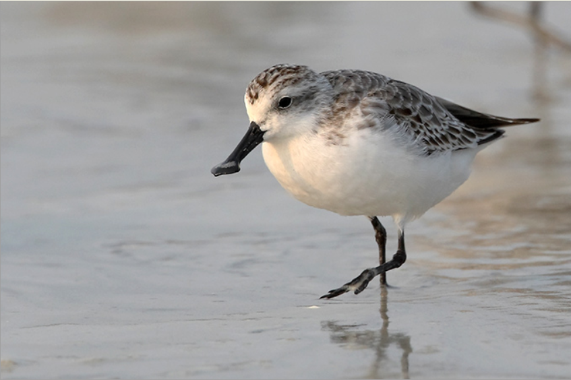
Direction Of Conservation:
Predicting distribution patterns and trends
Data from: Movebank
It is a free, online database of animal tracking data
hosted by the Max Planck Institute for Ornithology.

Slide 4
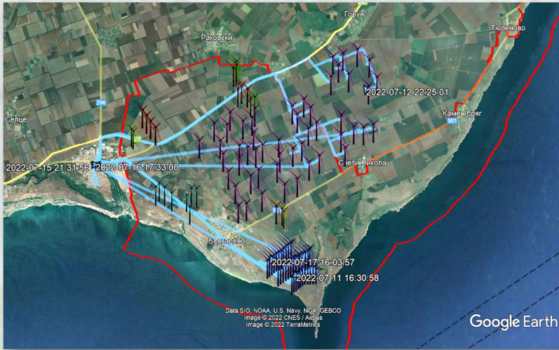
Direction Of Conservation:
Hardware device management
Early warning systems can manage and minimize the risk of birds colliding with rotating components of wind turbines by stopping individual or groups of turbines or entire wind farms, as well as monitoring conservation important species during dangerous times

Slide 5
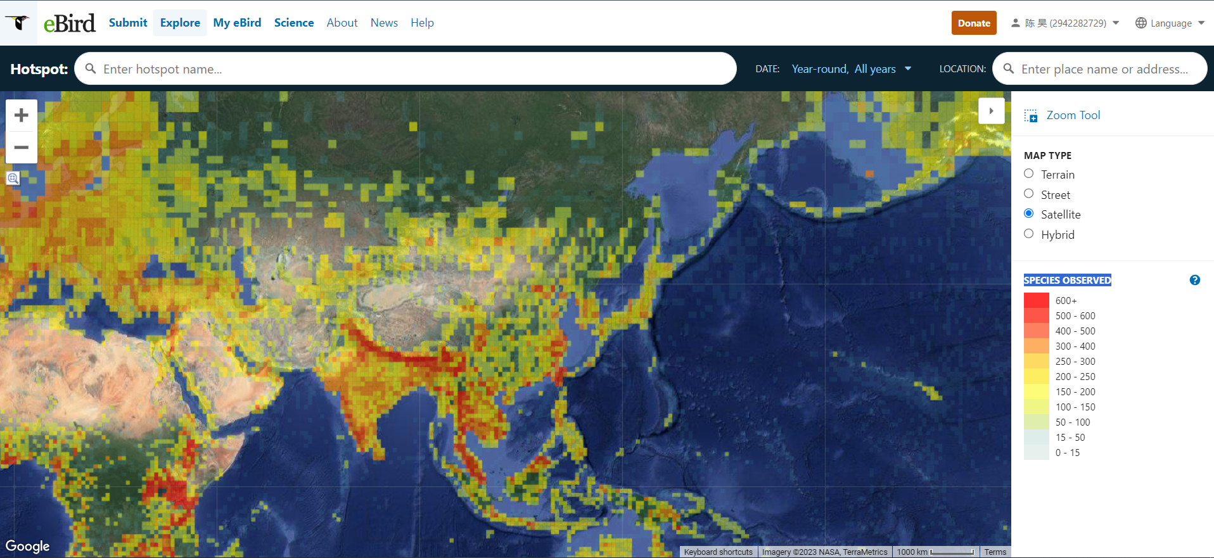
Direction Of Conservation:
Population densities

Slide 6
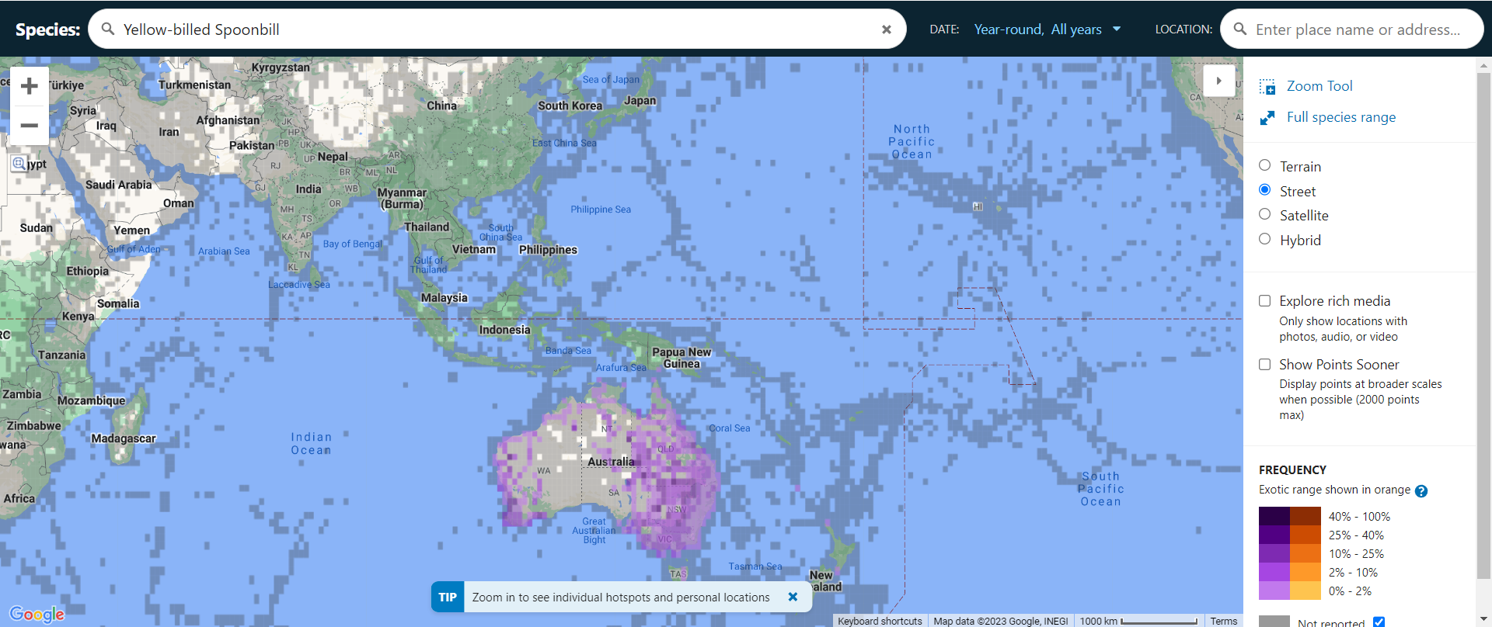
Direction Of Conservation:
Accurate maps of species ranges are essential to inform conservation

Slide 7
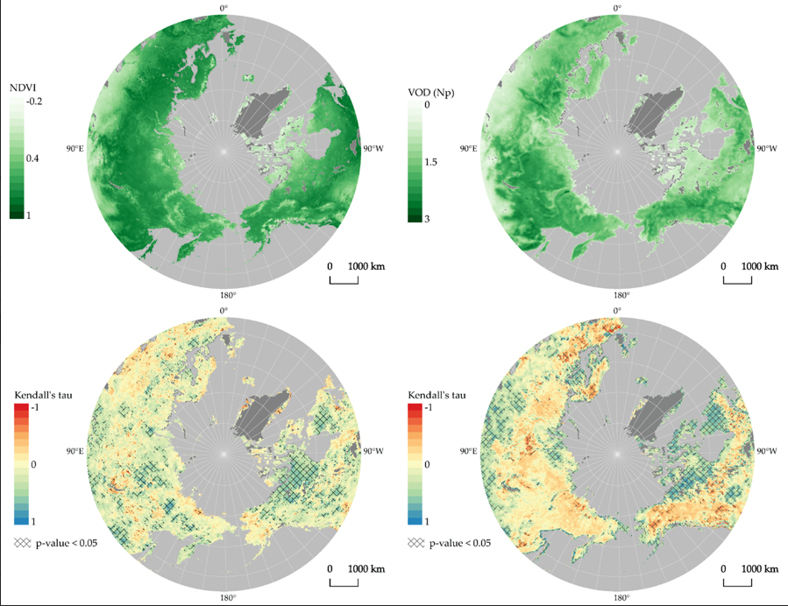
Direction Of Conservation:
Ecological environment remote sensing monitoring
The long-term remote sensing data of habitat were obtained and systematically analyzed

Slide 8



Direction Of Conservation:
Establish a bird species database for our system
Video | Sound | Attributes

Slide 9
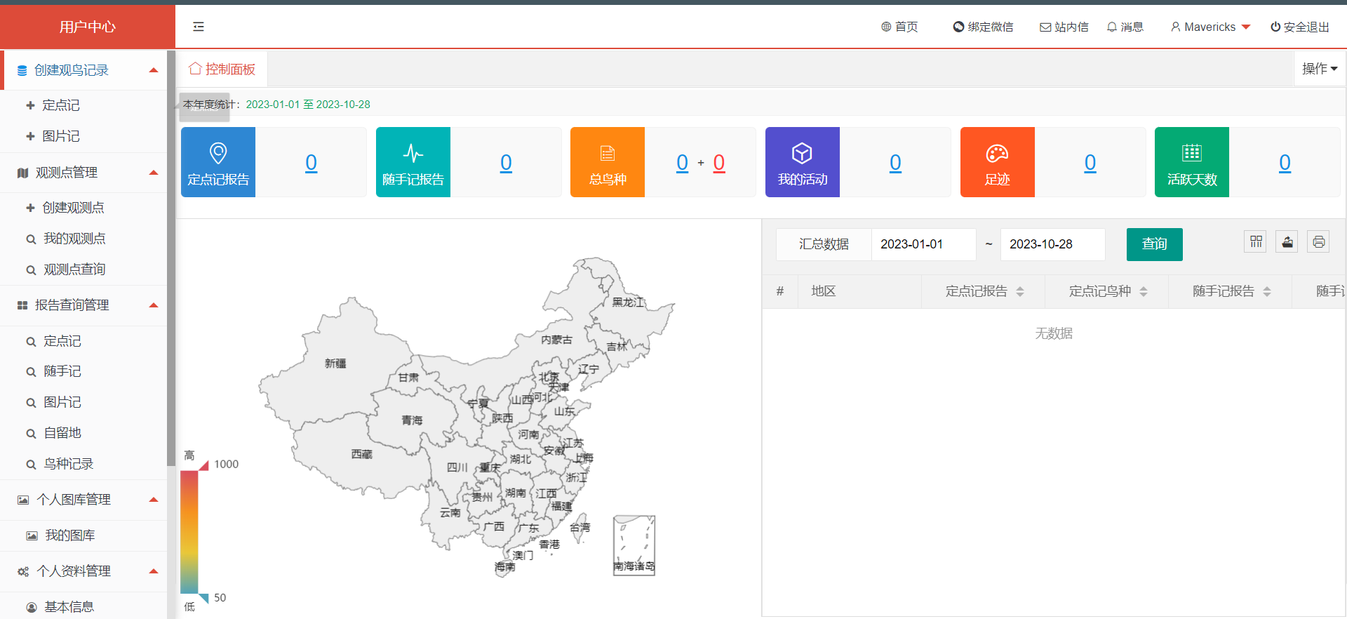
Direction Of Conservation:
Data upload

Slide 10

Direction Of Conservation:
Application of artificial intelligence in bird protection system
Simplify data upload with pattern recognition and classification technology

Slide 11


The biggest difficulty
Network-based transmission
Lack of our own hardware equipment

